Slide 1
Introduction to Web Programming
Lecture 10: Introduction to JavaScript (Part 3)
HTML DOM
Natheer Gharaibeh

Slide 2
Outlines of today’s lecture
•
What’s DOM?
•
How to find HTML elements in the document.
•
How to change the content, attributes and style of HTML elements.

Slide 3
What is DOM?
The DOM defines a standard for accessing documents: "The W3C Document Object Model (DOM) is a platform and
language-neutral interface that allows programs and scripts to dynamically access and update the content, structure, and style of a document.”
When a web page is loaded, the browser creates a Document Object Model (DOM) of the page.
The HTML DOM is considered as a tree of objects.

Slide 4
What is DOM? (cont.)
The Document Object Model, or DOM, is the fundamental API for representing and manipulating the content of HTML documents. It defines:
The HTML elements as objects
The properties of all HTML elements
The methods to access all HTML elements
The events for all HTML elements
In other words: The HTML DOM is a standard for how to get, change, add, or delete HTML elements.

Slide 5

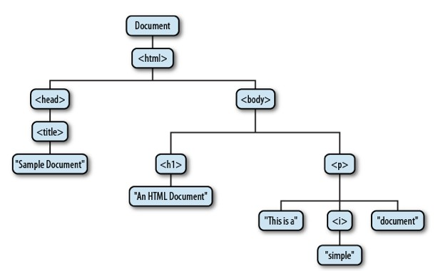
Overview of the DOM
<html>
<head>
<title>Sample Document</title>
</head>
<body>
<h1>An HTML
Document</h1>
<p>This is a
<i>simple</i> document.
</body>
</html>

Slide 6
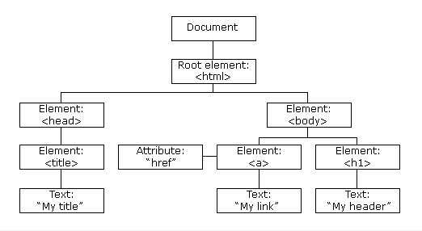
How Is It Created?
•The HTML DOM model is constructed as a tree of Objects:

Slide 7
Overview of the DOM (Cont.)
•The node directly above a node is the parent of that node.
•The nodes one level directly below another node are the
children of that node.
•Nodes at the same level, and with the same parent, are
siblings.
•The set of nodes any number of levels below another node are the descendants of that node.
•And the parent, grandparent, and all other nodes above a node are the ancestors of that node.

Slide 8
The DOM Document
In the HTML DOM object model, the document object represents your web page.
The document object is the owner of all other objects in your web page.
If you want to access objects in an HTML page, you always start with accessing the document object.

Slide 9
The DOM Programming Interface
•The HTML DOM can be accessed with JavaScript (and with other programming languages).
•In the DOM, all HTML elements are defined as objects.
•The programming interface is the properties and methods of each object.
•A property is a value that you can get or set (like changing the content of an HTML element).
•A method is an action you can do (like adding or deleting an HTML element).

Slide 10
The DOM Programming Interface (Cont.)
•
The getElementById Method
The most common way to access an HTML element is to use the id of the element.
•
The innerHTML Property
The easiest way to get the content of an element is by using the innerHTML property.
The innerHTML property is useful for getting or replacing the content of HTML elements.
The innerHTML property can be used to get or change any HTML element, including <html> and <body>.

Slide 11
Properties and Methods–Example
The following example changes the content (the innerHTML) of the <p> element with id="demo":
<html>
<body>
<p id="demo"></p>
<script>
document.getElementById("demo").innerHTML = "Hello World!";
</script>
</body>
</html>
• In the example above, getElementById is a method, while
innerHTML is a property

Slide 12
HTML DOM Elements
Finding HTML Elements
•Often, with JavaScript, you want to manipulate HTML elements.
•To do so, you have to find the elements first. There are a number of ways to do this, a few are listed as follows:
Finding HTML elements by id
Finding HTML elements by tag name
Finding HTML elements by class name
Finding HTML elements by HTML object collections

Slide 13
1. Finding HTML Elements by Id
•Any HTML element can have an id attribute.
•The value of this attribute must be unique within the document—no two elements in the same document can have the same ID.
•The easiest way to find HTML elements in the DOM, is by using the element id.
You can select an element based on this unique ID with the
getElementById() method of the Document object
•If the element is found, the method will return the element as an
object.
•If the element is not found, the method will return null.

Slide 14
1. Finding HTML Elements by Id–Example
•This example finds the element with id=“intro":
<body>
<p id="intro">Hello World!</p>
<p>This example demonstrates the <b>getElementById</b> method!
</p>
<p id="demo"></p>
<script>
var myElement = document.getElementById("intro");
document.getElementById("demo").innerHTML =
"The text from the intro paragraph is " + myElement.innerHTML;
</script>
</body>

Slide 15
2. Finding HTML Elements by Tag Name
•You can select all HTML elements of a specified type (or tag name) using the getElementsByTagName() method.
•getElementsByTagName() returns a NodeList object.
•The nodes in the node list can be accessed through their
index number (starting from 0).
•The elements of the returned NodeList are in document order, so you can select the first <p> element of a document like this:
var firstpara = document.getElementsByTagName("p")[0];

Slide 16
2. Finding HTML Elements by Tag Name–Example
•This example finds the element with id="main", and then finds all <p> elements inside "main":
<div id="main">
<p>The DOM is very useful.</p>
<p>This example demonstrates the <b>getElementsByTagName</b> method</p>
</div>
<p id="demo"></p>
<script>
var x = document.getElementById("main"); var y = x.getElementsByTagName("p");
document.getElementById("demo").innerHTML =
'The first paragraph inside "main" is ' + y[0].innerHTML;
</script>

Slide 17
3. Finding HTML Elements by Class Name
•You can select all HTML elements of a specified class using the getElementsByClassName() method.
•It returns a live NodeList containing all matching descendants of the document or element.

Slide 18
4. Finding HTML Elements by HTML Object Collections
•The Document Object Model contains several collections, which are groups of related objects on a page.
•DOM collections are accessed as properties of DOM objects such as the document object or a DOM node. The document object has properties containing the
images collection
links collection
forms collection
anchors collection
These collections contain all the elements of the corresponding type on the page.

Slide 19
4. Finding HTML Elements by HTML Object Collections–Example
<html>
<body>
<a name=“html”>HTML Tutorial</a><br>
<a name="css">CSS Tutorial</a><br>
<a name="xml">XML Tutorial</a><br>
<p id="demo"></p>
<script> document.getElementById("demo").innerHTML =
"The content of the first anchor is: " + document.anchors[0].innerHTML;
</script>
</body>
</html>

Slide 20
Changing HTML Content
The easiest way to modify the content of an HTML element is by using the
innerHTML property.
Write the script that will change the content of the <p> element to “Good Morning!”
<html>
<body>
<p id="p1">Hello World!</p>
<script>
?
</script>
</body>
</html>

Slide 21
Changing the Value of an Attribute
To change the value of an HTML attribute, use this syntax:
document.getElementById(id).attribute=new value
Write a script that changes the value of the src attribute of the <img> element to “image1.gif”:
<!DOCTYPE html>
<html>
<body>
<img id="myImage" src="smiley.gif">
<script>
?
</script>
</body>
</html>

Slide 22
Changing HTML Style
To change the style of an HTML element, use this syntax:
document.getElementById(id).style.property=new style Write a script that changes the text color of the <p> element
<html>
<body>
<p id="p2">Hello World!</p>
<script>
</script>
<p>The paragraph above was changed by a script.</p>
</body>
</html>

Slide 23
References
www.w3schools.com
Flanagan, David. JavaScript: The definitive guide: Activate your web pages. O'Reilly Media, Inc., 2011.
Deitel & Deitel (2011). Internet and World Wide Web How to Program, 5th Edition, Harvey & Paul Deitel & Associates.

